Slide 1
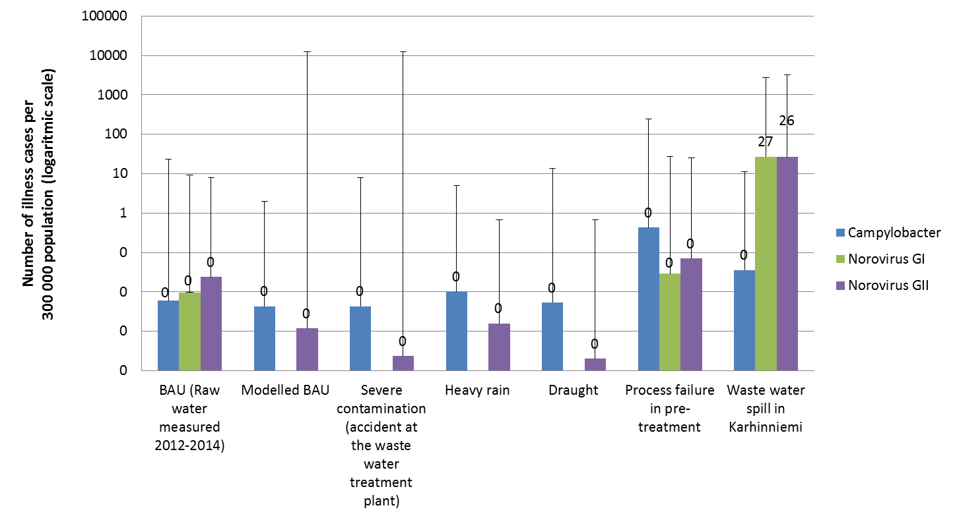
Microbiological health risks in drinking water after artificial groundwater recharge process
Health risks related to raw water quality in artificial groundwater recharge
Artificial groundwater recharge (AGR) using surface water as raw water is an increasing method to produce drinking water to the communities. The raw water quality is an issue since surface water resources typically receive municipal or industrial waste waters and loads from catchment area. Sewage overflows, draught and floods are the most typical situations causing raw water quality problems and subsequently may pose a risk to human health via drinking water.
Material and methods
Predictive Monte Carlo Quantitative Microbial Risk Assessment (QMRA) method (Haas 1999) was applied to estimate the probability of infection using Analytica software. The estimation was based on measured (in 2012-2014) norovirus (genogroups I and II), Campylobacter spp. and Salmonella spp. and modelled Escherichia coli and norovirus GII counts in the raw water uptake site in Karhiniemi. The microbial removal efficiency of pre-treatment, AGR and disinfection was mainly assessed based on existing literature. Retention time in the AGR process was not taken into account. Further, dose-response values from literature were utilized taking into account species level information in the raw water uptake site. (Table 1). In addition to business as usual (BAU) situation, several scenarios were assessed: accident in the upstream municipal waste water treatment plant, heavy rain, draught, process failure in pre-treatment and direct waste water spill into raw water uptake site.
Results
Especially Campylobacter spp. was commonly detected in raw water uptake site (92 % of samples positive) and Campylobacter jejuni was the most common species detected. 15 % of samples were positive for Salmonella spp. (S. Typhimurium), 23 % and 39 % for norovirus genogroups I and II, respectively.
As a result from the health risk assessment, the most severe contamination scenario, direct waste water spill into the raw water uptake site in Karhiniemi (Campylobacter spp. and Salmonella spp. 1000 microbes/L; noroviruses 100 000 microbes/L), caused on average 53 (min:0; max:5988) gastrointestinal illness cases per day among the water consumers (Fig. 2.). Illness cases were mostly caused by noroviruses. Additionally Campylobacter spp. exposure in process failure scenario in pre-treatment resulted on average one illness case per 300 000 inhabitants. Salmonella did not cause any illness cases in any of the contamination scenarios. Based on measured and modelled BAU scenarios, the removal efficiency of drinking water production process was proved to secure the good microbiological quality of the drinking water.
Study outline
The river water of the Kokemäenjoki River water course in southwestern part of Finland (Fig. 1) is used for AGR after pre-treatment using combined coagulation and sand filtration. AGR is done at Virttaankangas esker and the produced drinking water serves population of 300 000 inhabitants in Turku region.
The aim of the study was to assess the health impacts to drinking water consumers using of raw water contamination scenarios in Turku region.
0.1
0.01
0.001
Figure 2. Average and maximum numbers of gastrointestinal illness cases per 300 000 inhabitants in Turku region in different contamination scenarios. Water retention time in the esker (AGR-process) was not included in the QMRA.
Concluions
Conclusions
AGR-process secures a good microbiological quality of drinking water in Turku region in Finland
The study provides valuable information for knowledge-based decision-making at the waterworks and at the municipal and regional level.
Various risk scenarios regarding to the raw water quality and risk management measures to minimize the negative health impact of drinking water to tap water consumers can be tested with the developed QMRA model.
Table 1. Key variables in the QMRA; distributions and references
Variable | Microbe | Distribution (min, mean, max) | Reference
Numbers in raw water | Campylobacter spp. | Lognormal (0.23; 136; 500) | Unpublished data (this study, micobe/liter).
 | Norovirus GI | Lognormal (1.14; 36; 250) | Unpublished data (this study, micobe/liter).
 | Norovirus GII | Lognormal (1.14; 93; 357) | Unpublished data (this study, micobe/liter).
 | Salmonella spp. | Lognormal (0.12; 0.17; 0.33) | Unpublished data (this study, micobe/liter).
Pre-treatment efficiency (log₁₀ removal) | Campylobacter spp. | Triangular (1, 2.1, 3,4) | Hijnen and Medema (2010). Elimination of micro-organisms by Drinking Water Treatment Processes. A review. IWA Publishing, UK.
 | Norovirus GI / GII | Triangular (1.2, 3, 5.3) | Hijnen and Medema (2010). Elimination of micro-organisms by Drinking Water Treatment Processes. A review. IWA Publishing, UK.
 | Salmonella spp. | Triangular (1, 2.1, 3,4) | Hijnen and Medema (2010). Elimination of micro-organisms by Drinking Water Treatment Processes. A review. IWA Publishing, UK.
AGR process efficiency (log₁₀ removal) | Campylobacter spp., Salmonella spp. | Uniform (0.4, -, 8.2 ) | Hyvärinen, Nina (2013). Master’s thesis. University of Eastern Finland. In Finnish.
 | Norovirus GI / GII | Uniform (0.03, -, 7.3 ) | Hyvärinen, Nina (2013). Master’s thesis. University of Eastern Finland. In Finnish.
Chlorination efficiency | All studied microbes |  | Petterson, S & Stenström, T. (2015). Journal of water and health 13 (3), 625-644
Dose–response | Campylobacter spp. | Beta Poisson approximation | Teunis et al. (2005). Epidemiology and Infection (133): 583-592. Campylobacter jejuni
 | Norovirus GI / GII | Exact beta Poisson | Teunis et al. (2008). Journal of Medical Virology 80: 1468-1476.
 | Salmonella spp. | Beta Poisson approximation | Teunis et al. (2010). International journal of Food Microbiology 144:243-249.
Infection to illness (%) | Campylobacter spp. | 33 | Nauta et al. (2007). Risk Analysis 27(4): 845-861.
 | Norovirus GI / GII | 67 | Atmar et al. (2014).The Journal of Infectious Diseases, 209:1016-1022.
 | Salmonella spp. | 18 | Teunis et al.. (1999). Risk analysis 19(6):1251-1260 .(Orig. McCullough and C.Wsley Eisele (1951). Journal of intectious diseases 88:278-289).
Contact information:
paivi.merilainen@thl.fi
+358 29 524 7826
Impact Assessment Unit
anna-maria.hokajarvi@thl.fi
+358 29 524 7715
Water and Health Unit
References
Haas et al 1999. Quantitative Microbial Risk Assessment, New York, NY: John Wiley & Sons, Inc

